Slide 1
Automatic regulation of release of water based upon soil moisture and temperature control system
Department of Electrical and Electronics Engineering
Velammal Engineering College.
PRESENTED BY:
ABIRAMI M
PAVITHRA S
THRISHA S

Slide 2
ABSTRACT
Automatic soil moisture irrigation systems are designed to monitor and control the moisture levels in the soil to efficiently deliver water to plants.
These systems use sensors to measure the moisture content in the soil, and based on that data, they automatically activate the irrigation system to water the plants when the soil becomes too dry.
This helps to prevent overwatering or underwatering, as the system only irrigates when necessary.
By maintaining optimal soil moisture levels, these systems can improve plant growth and reduce water waste.
Overall, automatic soil moisture irrigation systems offer a sustainable and hands-free solution for watering plants, promoting healthier landscapes while conserving water resources.

Slide 3
INTRODUCTION
Automatic water irrigation systems are watering systems that are designed to automatically deliver water to plants in a garden or landscape.
These systems are typically controlled by a timer or sensor, which enables them to water plants at specific times or when the soil becomes too dry.
Automatic water irrigation systems can help to save time and water, as they ensure that plants receive the proper amount of water consistently.
These systems can be set up to water individual plants, specific areas of a garden, or an entire landscape, making them a convenient and efficient way to keep plants healthy and hydrated.

Slide 4
OBJECTIVES
To reduce water usage by applying irrigation only when necessary, based on soil moisture levels. To optimize crop productivity by maintaining optimal soil moisture levels.

Slide 5
PROBLEM STATEMENT
Current irrigation practices often lack accuracy and efficiency, resulting in over- or under-irrigation, which can lead to water wastage, decreased crop productivity, and increased environmental impact.
Farmers need a reliable and automated irrigation system that utilizes real-time soil moisture data to determine the optimal timing and amount of irrigation to optimize crop growth and minimize resource

Slide 6
EXISTING SOLUTION
If soil will get dry then sensor senses low moisture level and automatically switches on the water pump to supply water to the plant.
As plant get sufficient water and soil get wet then sensor senses enough moisture in soil. After which the water pump will automatically get stopped.

Slide 7
PROPOSED SOLUTION
Consider integrating machine learning algorithms that adapt over time to specific crop and soil conditions.
This dynamic AI system could continuously optimize valve adjustments based on historical data, weather forecasts, and crop growth stages, enhancing precision and water-use efficiency in the piped and micro irrigation network.
Some plants need more water and some does not need much so it senses it and produces as a data of how much water is need for a particular plant ,so that the water will not be get wasted.

Slide 8
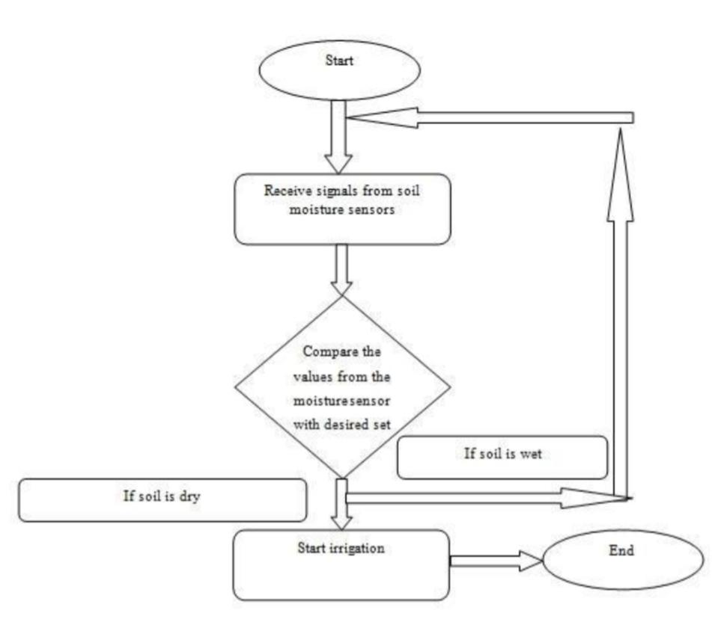
FLOWCHART

Slide 9
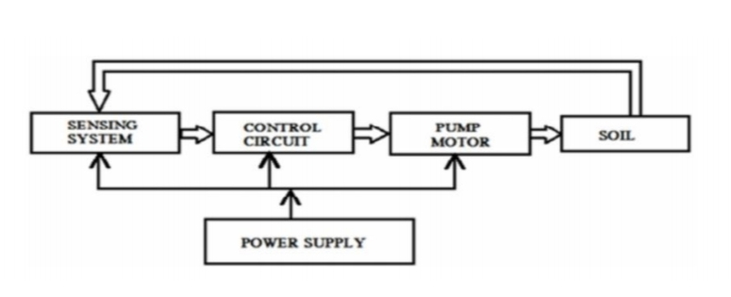
BLOCK DIAGRAM

Slide 10
COMPONENTS REQUIRED
Moisture sensor 5V Relay Module 7805 Regulator
Dc Pump
9 V Battery
Temperature sensor

Slide 11
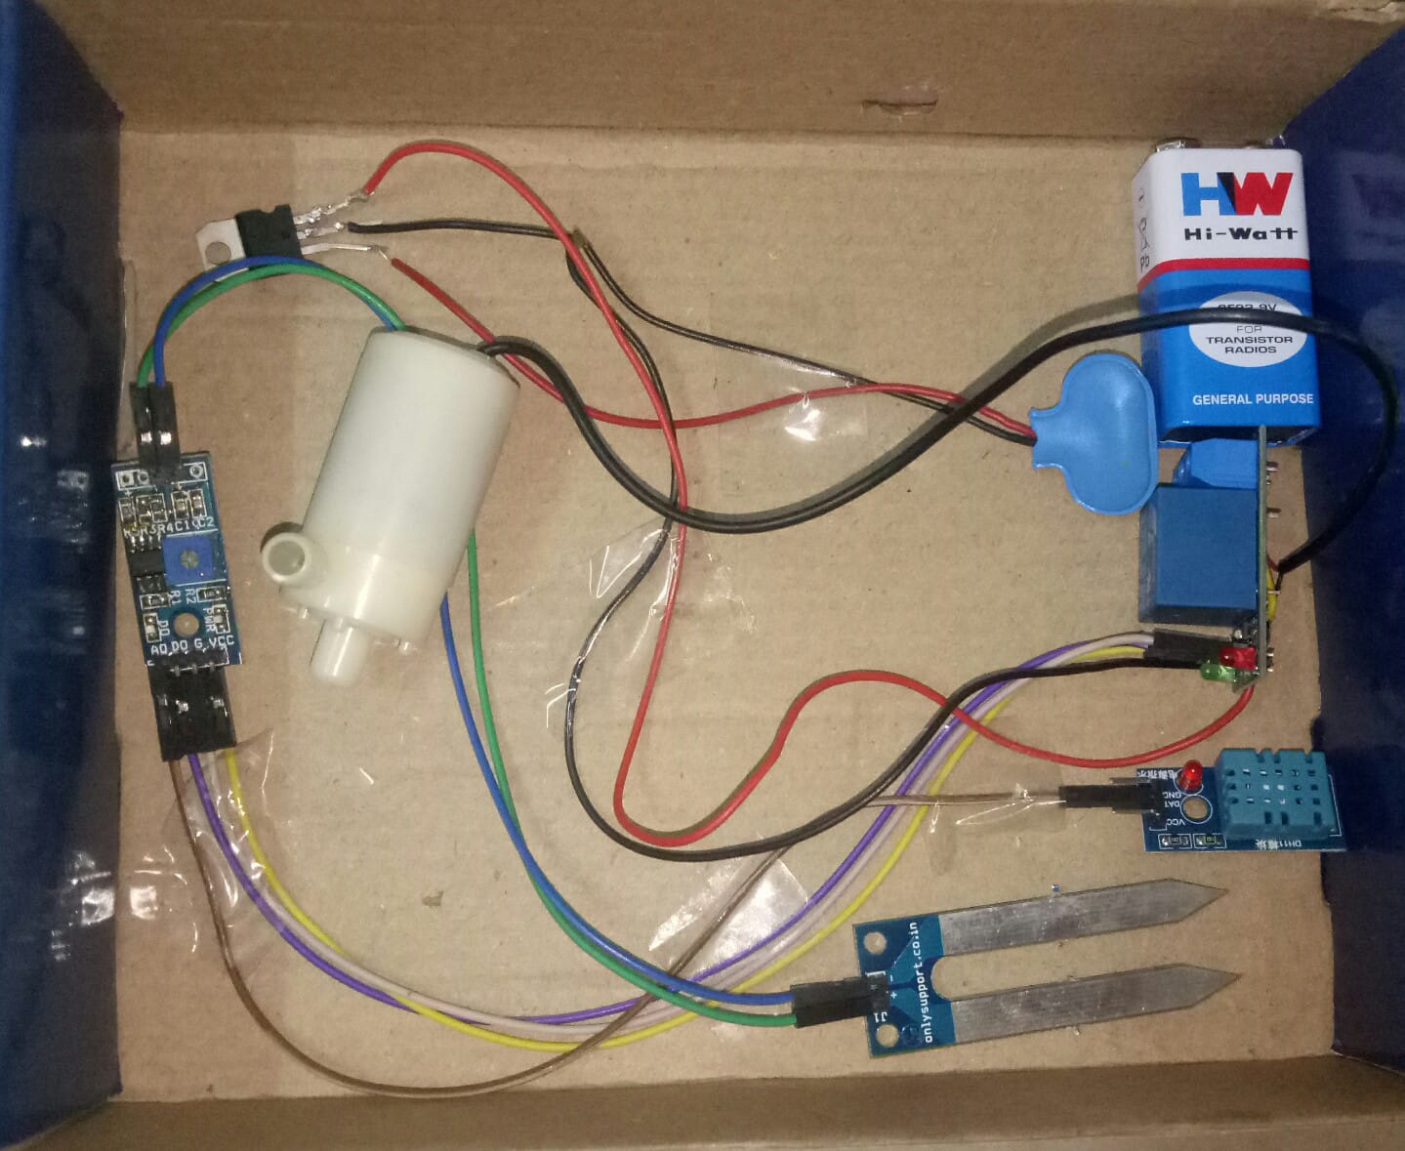

Slide 12
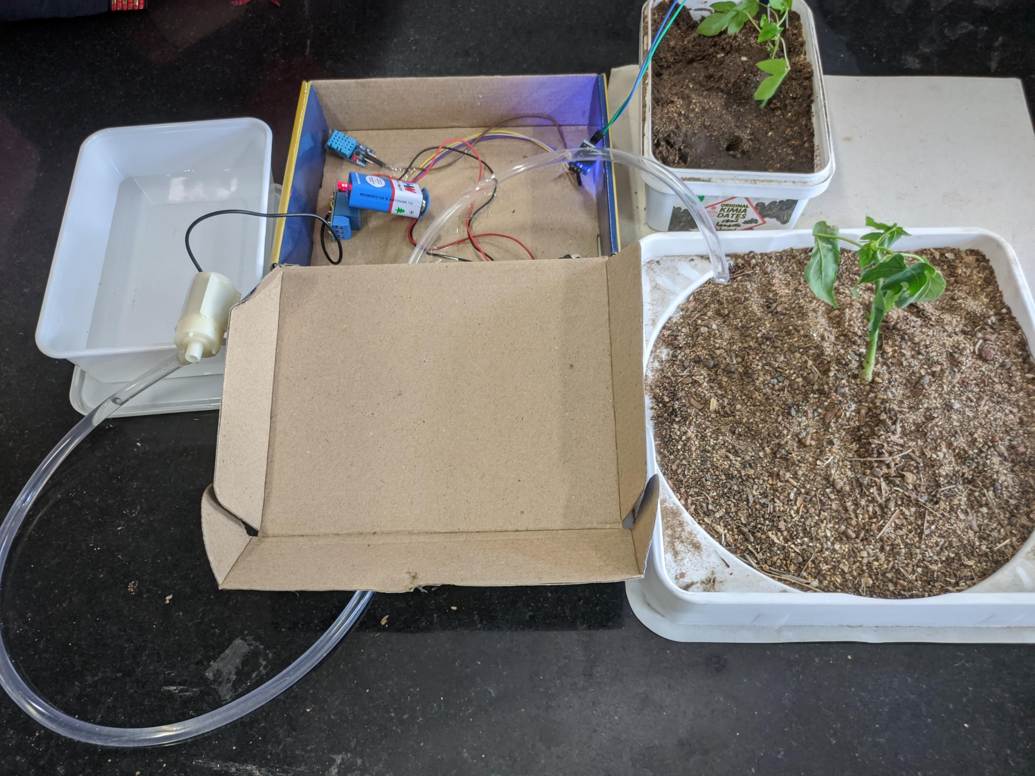

Slide 13
CONCLUSION
By activating the pump only when required, it ensures precise irrigation, conserves water, reduces manual effort, and supports optimal plant growth.
This low-cost, energy-efficient solution demonstrates the effective integration of simple electronic components for sustainable agriculture.

Slide 14
THANK YOU

